Slide 1
Understanding Asynchrony in Javascript

Slide 2


Hello!
I AM HOWIE REITH
Software Developer
Howard.Reith@gmail.com
https://github.com/howardreith/understanding-asynchrony

Slide 3
What is Asynchrony?
1

Slide 4

What is Asynchrony?
Imagine you’re an airline running a ticket counter with only one agent. Things are mostly fine, but sometimes things go wrong.
Customers forget their bags.
They need to consult their families.
They can’t speak the agent’s language.
They’re confused or just really slow.

Slide 5

What is Asynchrony?
The longer things take, the more annoyed your customers become. What can you do?
Hire more agents.
Different lines for different tasks.
“Express” line and “customer service” line.
Give customers a time limit.

Slide 6
What is Asynchrony?
Asynchrony in computer science concerns how we deal with these sorts of problems in a computer. How does our system behave when things are slow?
In web development, Javascript is a single-threaded language, which means it executes its processes synchronously, one after another. You cannot, out of the box, have two functions running at the same time.

Slide 7
What is Asynchrony?
Why is this a problem?
Everything grinds to a halt. Nothing can be done while we’re waiting for something slow, and such situations are common.
API calls
User input
Long loops and recursive functions
setTimeout
Errors

Slide 8
What is Asynchrony?
Why should we care?
Managing asynchrony is a challenging and frequent issue we face.
Making sure our asynchronous functions happen in order is essential to our apps’ functionalities.
Solving these problems poorly will cause slow performance and poor user experiences.
Understanding what’s happening will make solving such problems easier and less stressful.

Slide 9
CPU vs. I/O Bound Code
2

Slide 10
CPU vs. I/O Bound Code
Two issues concerning asynchrony:
CPU-bound issues concern “Can I make my code run faster by spreading the workload across multiple heads?” It’s about maximizing efficiency by recognizing processes that can run independently of one another.
I/O-bound issues concern things you have to wait for – API calls, user inputs, etc. These issues cannot be improved by adding additional threads and, in fact, doing so will make the code run slower.
Web development is concern almost entirely with I/O-bound issues, but we’ll briefly touch on multithreading.

Slide 11
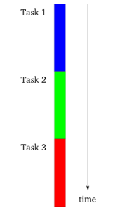
CPU vs. I/O Bound Code
Imagine you’re programming and you only have access to a single synchronous thread. In the event of an error, you want your users to be able to abort the process and move on. How can you give your users an “escape” process if your computer’s locked in a loop or an error?

Slide 12
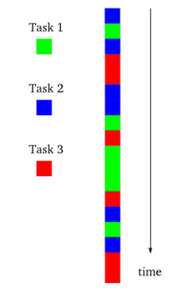
CPU vs. I/O Bound Code
What if you staggered the process? “I’m going to work on thread 1 for a bit, then switch to thread 2, then back to 1, then to 3…” By alternating between threads you avoid getting locked into any single process.
Note that unless you actually encounter a problem this will be necessarily slower than a synchronously-run thread, since you must run the additional logic to switch between the processes.

Slide 13
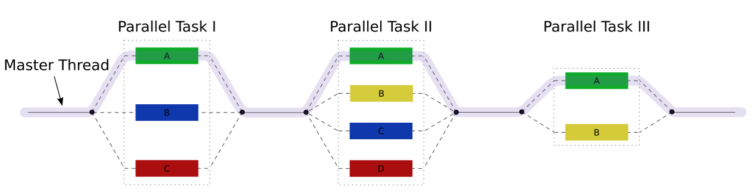
CPU vs. I/O Bound Code
If you have identified several processes in your code that do not depend on each other for completion, and you have multiple heads in your processor, you can divide the load between these heads and thereby improve the processing speed of your code.
If your processes are dependent on each other, your code may actually run slower with this arrangement as each process waits for its prerequisite to finish in the other heads.

Slide 14
CPU vs. I/O Bound Code
Quiz
Which is faster – executing code synchronously or concurrently (multi-threaded)?

Slide 15
CPU vs. I/O Bound Code
Quiz
Which is faster – executing code synchronously or concurrently (multi-threaded)?
It depends. If there are multiple processes that can be run independently, multithreading will be faster. If each process is dependent on the ones before, synchronous processing will be faster (since it eliminates the asynchronous logic).

Slide 16
Javascript and the Browser
3

Slide 17
Javascript and the Browser
The Call Stack
To execute processes synchronously your browser uses what’s called the Call Stack.
A stack is last in, first out. Think of it like stacking plates. When you add a plate to a pile, you must remove the top plate before you can remove additional plates.

Slide 18
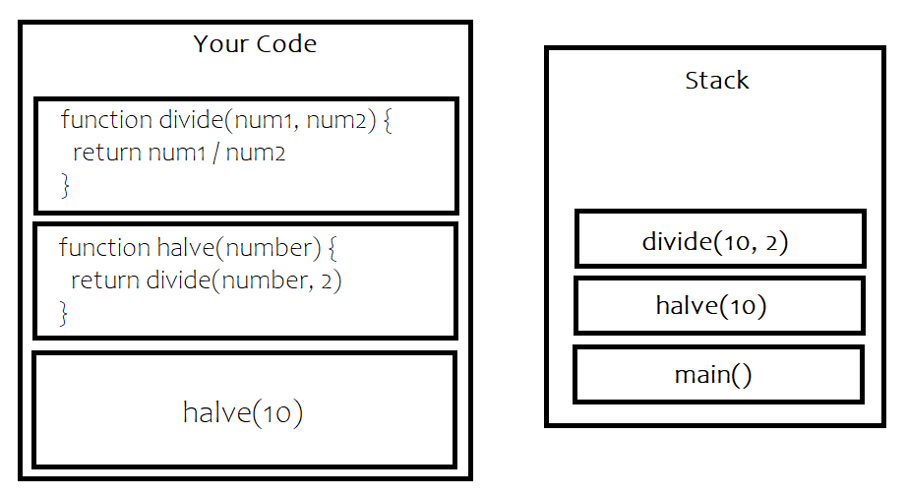
Javascript and the Browser

Slide 19
Javascript and the Browser
How does JS do anything asynchronous?
While your JS code is single-threaded, it is not the only resource available to your browser. Your browser has a variety of Web APIs at its disposal including the Document Object Model (DOM), ajax (xmlhttprequest), setTimeout, and more. These APIs outside your JS code allow for asynchronous behavior.
Node also has APIs available, but they’re C++ APIs rather than these Web APIs.

Slide 20
Javascript and the Browser
The Task Queue and the Event Loop
Imagine you have some code that uses the “setTimeout” function, let’s say with a timeout of two seconds. When you call the setTimeout API, it will run its timer for two seconds. When complete, it pushes the callback function you passed into setTimeout into a queue called the Task Queue. Meanwhile, a while loop called the Event Loop watches the Task Queue. As soon as the Call Stack is empty, the Event Loop pushes anything that’s in the Task Queue into the Call Stack, where it’s then executed.

Slide 21
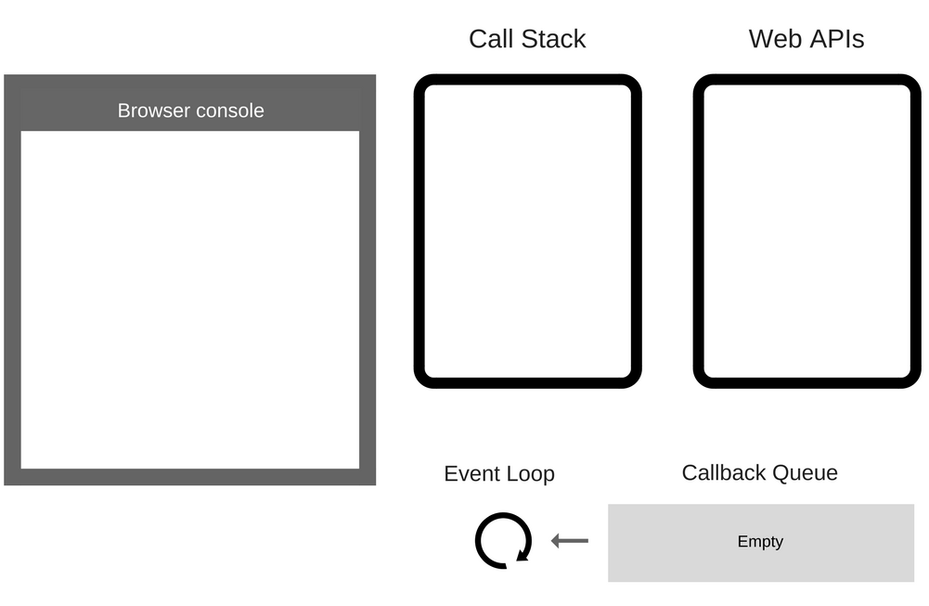
Javascript and the Browser
console.log("Star");
setTimeout(function cb() {
console.log("A New Hope");
}, 2000);
console.log("Wars");

Slide 22
Javascript and the Browser
“Star” Clog

Slide 23
Javascript and the Browser
Star

Slide 24
Javascript and the Browser
Star
setTimeout with callback

Slide 25
Javascript and the Browser
Timer… ->
Callback
Star

Slide 26
Javascript and the Browser
Timer… ->
Callback
Star
“Wars” Clog

Slide 27
Javascript and the Browser
Timer… ->
Callback
Star
Wars

Slide 28
Javascript and the Browser
Star
Wars
Timer Done!
Callback

Slide 29
Javascript and the Browser
Star
Wars
Oh hey! There is something in the
queue and the stack is empty!
Callback

Slide 30
Javascript and the Browser
Star
Wars
Callback

Slide 31
Javascript and the Browser
Star
Wars
A New Hope

Slide 32
Javascript and the Browser
Demonstration
Let’s demonstrate this with an external API call inside of the Google Chrome console.
console.log("We’re starting here!");
fetch("https://jsonplaceholder.typicode.com/posts/1") .then(response => response.json())
.then(json => console.log(json));
console.log("A bunch of latin is gonna come!");

Slide 33
Javascript and the Browser
Quiz
In what order will these strings appear in the console? Why?
setTimeout(function cb() { console.log("The Empire") }, 0);
console.log("Strikes");
console.log("Back");

Slide 34
Javascript and the Browser
Quiz
In what order will these strings appear in the console? Why?
setTimeout(function cb() { console.log("The Empire") }, 0);
console.log("Strikes");
console.log("Back");
“Strikes”, “Back”, “The Empire”
Even though the timeout has been set to 0 ms, the callback console.log will only be called once the stack is empty.

Slide 35
Callbacks, Promises, & Async Await
4

Slide 36
Callbacks, Promises, & Async Await
function getSomething (callback) {
setTimeout(() => {
callback ({ text: 'this will appear second' })
}, 2000)}
getSomething(thing => {
console.log(thing.text)})
console.log("this will appear first")
The simplest way to handle asynchronous behavior is with callbacks. getSomething accepts a callback which is invoked by setTimeout. The callback (console.log in this case) is added to the task queue, and when the stack is empty, the event loop pushes it back onto the stack, which executes it.

Slide 37
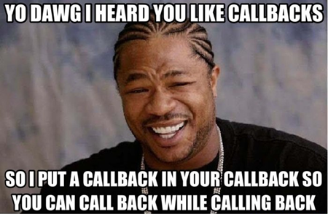
Callbacks, Promises, & Async Await
Callbacks are a fine way way to deal with asynchronous behavior except for when you have an async call that’s contingent on another async call.
The only solution is to put one callback inside of another, which can lead to callback hell.

Slide 38
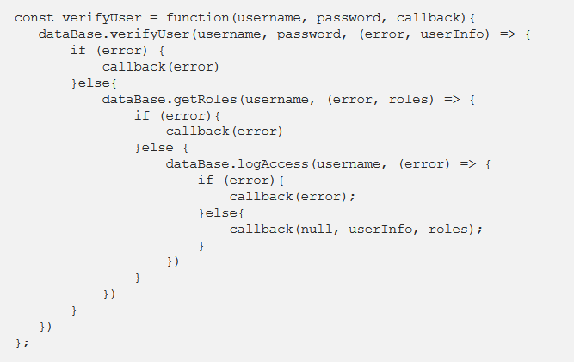
Callbacks, Promises, & Async Await

Slide 39
Callbacks, Promises, & Async Await
Promises
Feature introduced to Javascript in ES6.
When you build your async function, you return a “new Promise,” which calls the constructor of the Promise class.
This constructor accepts a callback called the executor function which contains as arguments functions that describe both resolution and error behavior for the asynchronous function.
When we invoke the function, we chain “.then” after we return. Each “.then” receives the return value of the previous. This allows us to handle several async calls without callback hell.
Error handling is managed with a single “.catch.”

Slide 40
Callbacks, Promises, & Async Await
function getSomething() {
return new Promise((resolve, reject) => {
setTimeout(() => {
let error = false;
if(!error) resolve({ text: "this will appear second" })
else reject() }, 2000)
})}
getSomething().then(thing => {
console.log(thing.text)})
.catch(error => {
console.log("Error occurred")
})
console.log("this will appear first");

Slide 41
Callbacks, Promises, & Async Await
fetch("https://jsonplaceholder.typicode.com/posts/1")
.then(response => {
return response.json()})
.then(response => response.id)
.then(response => {
const newId = response + 1
return fetch("https://jsonplaceholder.typicode.com/posts/" + newId)})
.then(response => {return response.json()})
.then(response => console.log(response))
.catch(function (error) {console.error(error);
}
);
We can chain .then statements and the second will wait for the response from the first, allowing us to make its call continent on the response of the first. Our .catch will handle all errors.

Slide 42
Callbacks, Promises, & Async Await
const promise1 = Promise.resolve(3);
const promise2 = new Promise(function(resolve, reject) { setTimeout(resolve, 200, "I am quickly resolved");
});
const promise3 = new Promise(function(resolve, reject) { setTimeout(resolve, 2000, "I take a while");
});
Promise.all([promise1, promise2, promise3])
.then(function(values) { console.log(values);});
Sometimes you’ll have multiple promises that you don’t want to chain, but you want to wait until they’re all resolved. For this, use the Promise.all method. Pass an array of all the promises as an argument and the return value will be an array of the resolutions.

Slide 43
Callbacks, Promises, & Async Await
Promises
While the error handling in the .then and the .catch might remind you of a try/catch, you cannot use try/catch with promises. Doing so will provoke an unhandled exception warning:
“UnhandledPromiseRejectionWarning: Unhandled promise rejection DeprecationWarning: Unhandled promise rejections are deprecated. In the future, promise rejections that are not handled will terminate the Node.js process with a non-zero exit code.“

Slide 44
Callbacks, Promises, & Async Await
Quiz
How do you handle errors in promises?

Slide 45
Callbacks, Promises, & Async Await
Quiz
How do you handle errors in promises?
With a .catch after your .then(s).

Slide 46
Callbacks, Promises, & Async Await
Async Await
Introduced in ES7 and Node 7.6
Async is used for declaring functions that will handle asynchronous operations.
Await is used to declare we want to wait for the result of an async operation within an async function.
A function can only have the “await” keyword if it is actually “awaitable,” that is to say, it returns a Promise.
Functions with the await keyword are interchangeable with functions that resolve Promises.

Slide 47
Callbacks, Promises, & Async Await
const getSomething = () => {
return new Promise((resolve, reject) => {
setTimeout(() => {
let error = false;
if(!error) resolve({ text: 'You got the thing' })
else reject() }, 2000)})}
async function fetchSomething () {
try { const thing = await getSomething()
return thing }
catch (error) { console.log("Error occurred") }}
fetchSomething()
.then(thing => console.log(thing.text))
.catch((error) => console.error(error))
fetchSomething is an async function.
It awaits getSomething which returns a Promise.
We store our promise’s resolution in “thing.”
With async/await, we can handle errors with try/catch.

Slide 48
Callbacks, Promises, & Async Await
const getSomething = () => {
return new Promise((resolve, reject) => {
setTimeout(() => {
let error = false;
if(!error) resolve({ text: 'You got the thing' })
else reject() }, 2000)})}
async function fetchSomething () {
try { const thing = await getSomething()
return thing }
catch (error) { console.log("Error occurred") }}
const theResult = await fetchSomething()
console.log(theResult.text)
Here is the same login but with the final result stored in a variable rather than using the .then syntax.
The functionality is nearly identical.

Slide 49
Callbacks, Promises, & Async Await
async function fetchSomething(){ return await fetch("https://jsonplaceholder.typicode.com/posts/1"); }
async function getSomeStuff(){ try { const thing= await fetchSomething();
return (thing.json()) } catch(error){ console.error(error) } }
console.log(await getSomeStuff())

Slide 50
Callbacks, Promises, & Async Await
Async Await
Essentially, this is nothing more than syntactical sugar built around Promises to make it look more synchronous and easier to read.
The primary benefit is aesthetic. Callbacks, Promises with .then, and Async Await all compile down to the same code and go through the event loop the same way. Use whichever approach is cleanest for humans to read in your use case. The computer doesn’t care.

Slide 51
Callbacks, Promises, & Async Await
Quiz
In what situation(s) would you use a callback?
Promises and .then?
Async Await?

Slide 52
Bibliography
Getting to know Asynchronous Javascript
Callbackhell
Mozilla Promises Documentation
Risingstack Asynchronous Javascript
Understanding Node JS Event Loop
Coding the Smart Way – Async Programming with Javascript
Quality Youtube video on the topic

Slide 53
Thanks for watching!
ANY QUESTIONS?
You can contact me at
Howard.Reith@gmail.com
You can contact me at
Howard.Reith@gmail.com
https://github.com/howardreith/understanding-asynchrony

